Slide 1

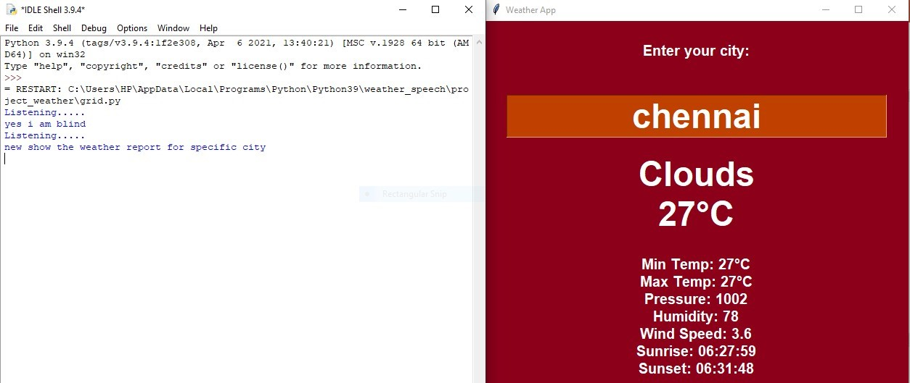
DEPARTMENT OF COMPUTER SCIENCE & APPLICATIONS G.L. Bajaj Institute of technology and management Major Project
Vikas verma 2201920140192
MCA(4th Sem)
A3
Under the Guidance of : Ms. Anju Mishra

Slide 2
Progress Report: Weather Forecasting Project
Introduction- The introduction provides a comprehensive overview of the project, emphasizing the importance of weather prediction for various sectors. It also acknowledges the scientific challenges associated with weather forecasting.
Aim and Scope- The project aims to develop a web application for weather forecasting. The scope of the project includes listing the system requirements, both hardware and software. The materials and methods used for developing the web application include Visual Studio Code, HTML, CSS, and JavaScript.

Slide 3
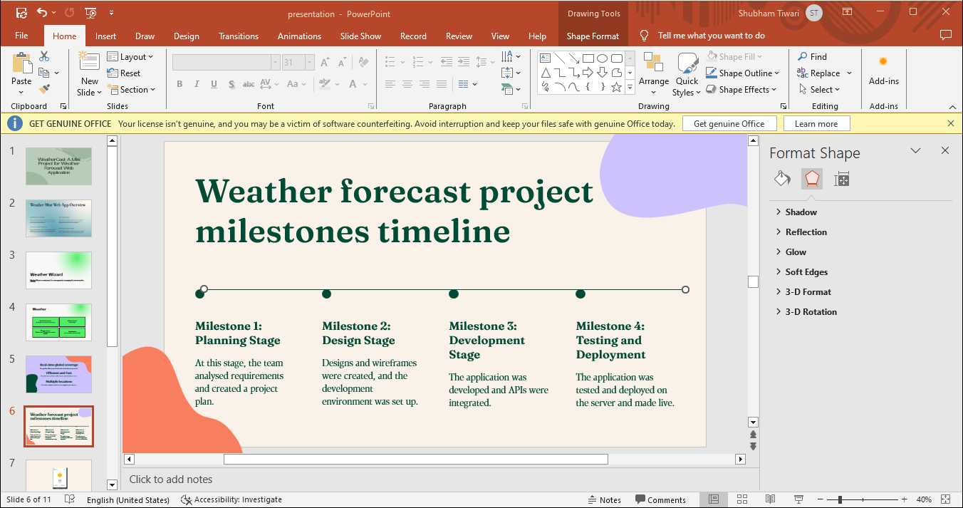

Slide 4
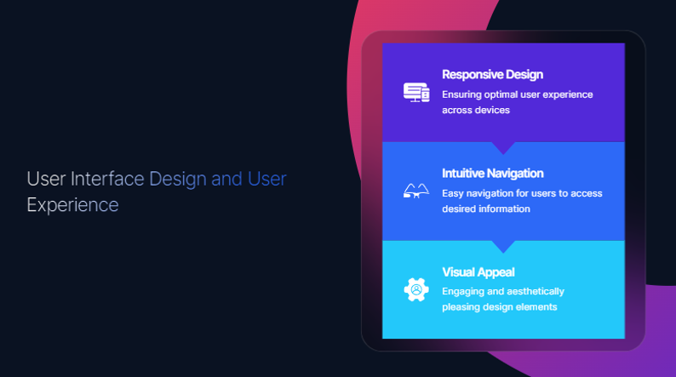
THE E XISTING SYSTEM
The existing system allows users to find weather forecast.

Slide 5
Weather Forecasting: A Challenging Task
Weather forecasting is a complex task that requires accurate predictions based on collected data. Traditional observations and numerical weather prediction models are used to make these forecasts. The importance of weather prediction is emphasized, as it is crucial for various sectors and has been a scientifically challenging problem.

Slide 6
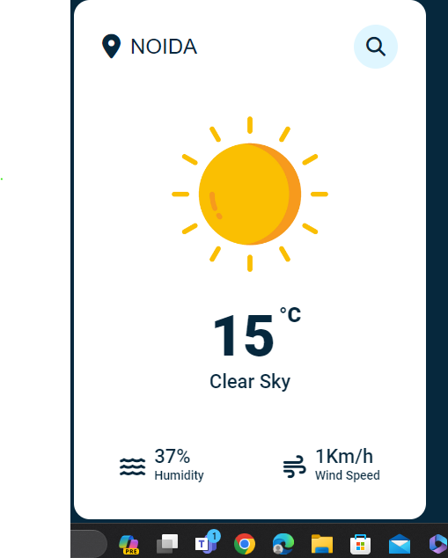
Results and Performance Analysis
The results and performance analysis section includes a diagram of the homepage of the web application.

Slide 7
Hardware and Software Requirement
Computer: A desktop or laptop computer is the primary hardware requirement.
Processor: A modern processor (e.g., Intel Core i3 or equivalent) is sufficient for basic notepad applications. More powerful processors may be needed for advanced features or large documents.
Memory (RAM): A minimum of 2GB of RAM is usually sufficient for basic notepad applications. More memory may be needed for larger documents or complex operations.
Display: A standard monitor or display screen with a resolution of 1024x768 or higher is recommended for a good user experience.

Slide 8
Hardware and Software Requirement
SOFTWARE:
Software requirements deals with defining resource requirements and prerequisites that needs to be installed on a computer to provide functioning of an application. The minimal software requirements are as follows,
Visual Studio Code
Windows / Mac

Slide 9
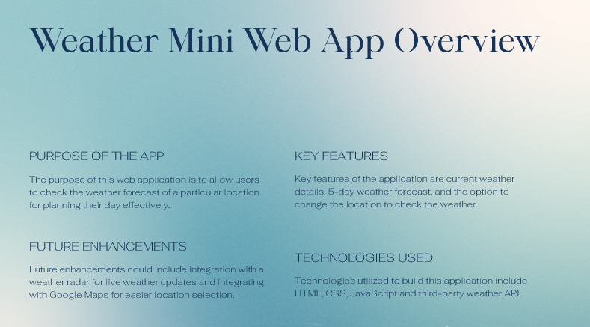

Slide 10
FUTURE SCOPE
The project aims to develop a web application for weather forecasting to provide accurate weather information to users.
The scope includes developing software for forecasting weather parameters like wind speed, cloud cover, and precipitation.
The system requirements involve hardware (e.g., hard disk, RAM, processor) and software (e.g., Visual Studio Code, HTML, CSS, JavaScript).
The architecture involves data collection, analysis, and presentation using numerical weather prediction models.
The results include a homepage diagram of the web application.
The conclusion states that while weather forecasting has improved, there is still room for enhancement.
Future work suggests developing a mobile application for timely weather updates.

Slide 11
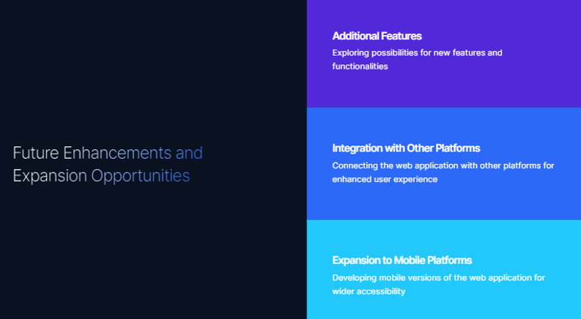

Slide 12
CONCLUSION
The conclusion acknowledges that while weather forecasting has improved, there is still room for improvement. Future work suggests developing a mobile application for timely weather updates. The report includes a list of references for further reading.

Slide 13
REFERENCES
W3School.
Google.
Weather Forecasting: A Comprehensive Study
Priya, S. B. A survey on weather forecasting to predict rainfall using big data analytics.

